Slide 1

Does Weather affect Customer Reviews of Restaurants?
Group 2: Fei Jin, Joyce Xu, Wendy Zhang,
Yuqing Chen and Kathleen Wade

Slide 2

Introduction
Business question
-Does weather affect the number and rank of reviews for restaurants?
Hypotheses
-Bad weather will reduce the review counts.
-Extreme weather will reduce the number of stars in review for a business.

Slide 3
Data Sources
Yelp Dataset
External: Weather Event Dataset (https://www.kaggle.com/datasets/sobhanmoosavi/us-weather-events)

Slide 4
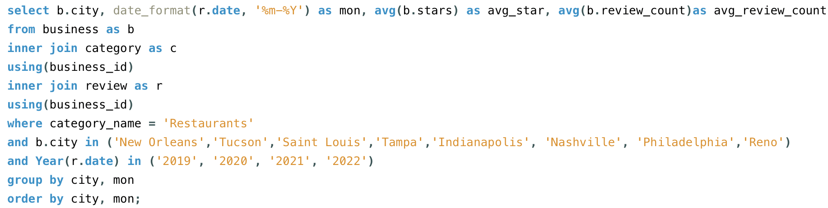
Data processing
Yelp dataset
City
Date
Review count
Star
Category = restaurant

Slide 5
Data processing
Weather dataset
City
Date
Sum of Precipitation
Count of Abnormal Weather Events
city_list = ['Indianapolis','Nashville','Philadelphia','Tampa','Tucson','New Orleans','Reno','Saint Louis']
city_data = df[df['City'].isin(city_list)]
# calculate the sum of precipitation in certain city at given year and month
precipitation_sum = city_data.groupby(['City', 'Date'])['Precipitation(in)'].sum().reset_index()
# calculate the sum of weather events in certain city at given year and month
events_sum = city_data.groupby(['City', 'Date', 'Type', 'Severity']).size().reset_index(name='Count')
merged_precipitation = pd.merge(precipitation_sum, yelp, left_on=['City', 'Date'], right_on=['city', 'mon'], how='inner')
merged_events = pd.merge(events_sum, yelp, left_on=['City', 'Date'], right_on=['city', 'mon'], how='inner')

Slide 6
Data processing
Weather dataset
City
Date
Sum of Precipitation
Count of Abnormal Weather Events
city_list = ['Indianapolis','Nashville','Philadelphia','Tampa','Tucson','New Orleans','Reno','Saint Louis']
city_data = df[df['City'].isin(city_list)]
# calculate the sum of precipitation in certain city at given year and month
precipitation_sum = city_data.groupby(['City', 'Date'])['Precipitation(in)'].sum().reset_index()
# calculate the sum of weather events in certain city at given year and month
events_sum = city_data.groupby(['City', 'Date', 'Type', 'Severity']).size().reset_index(name='Count')
merged_precipitation = pd.merge(precipitation_sum, yelp, left_on=['City', 'Date'], right_on=['city', 'mon'], how='inner')
merged_events = pd.merge(events_sum, yelp, left_on=['City', 'Date'], right_on=['city', 'mon'], how='inner')

Slide 7
Data used
Cities Selected
8 cities chosen: Indianapolis, Nashville, New Orleans, Philadelphia, Reno, St. Louis, Tampa, and Tucson
Represent different regions/weather patterns in the US
Had the largest number of reviews
Weather Data used
Counts of Severity of weather events
Precipitation in inches
Notes:
We chose to focus on 8 cities in our analysis
They were chosen by trying to choose different regions of the US and therefore different climates
We also chose cities that had the most restaurant yelp reviews so that there would be enough data for us to work with
For the weather data we choose to focus on how severity of events impacted reviews and inches of precipitation.

Slide 8
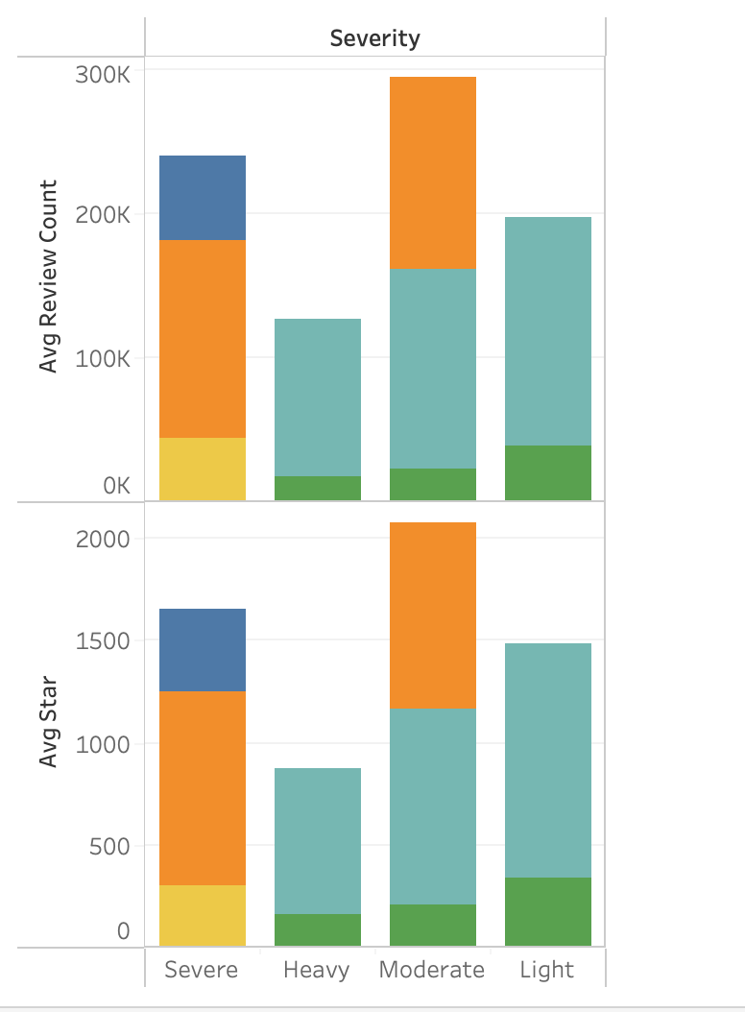
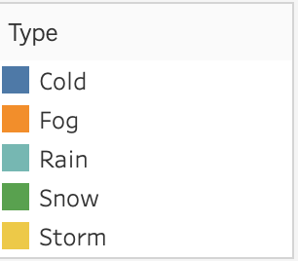
Weather Severity vs. Reviews
No Trend in Average Reviews/Stars and the severity of the weather
Highest number of reviews happen when the weather is Severe or Moderate

Slide 9
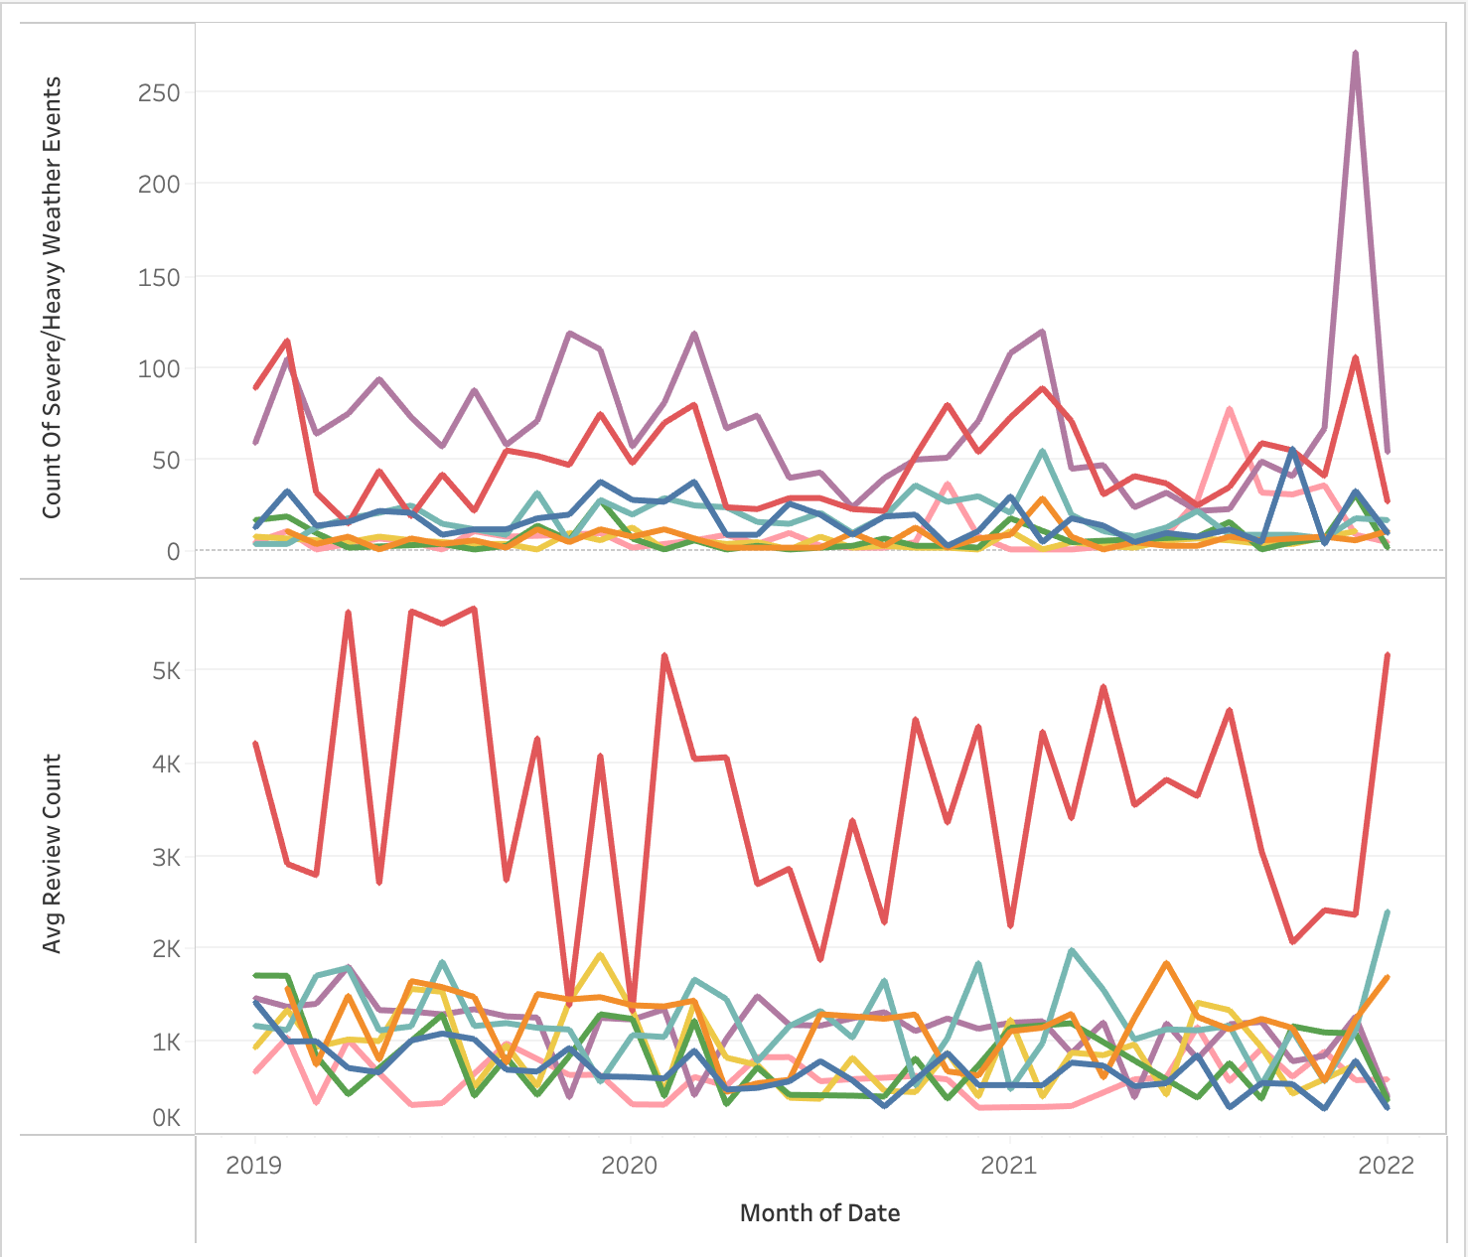
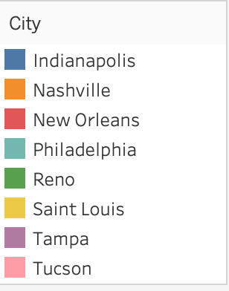
Severity and Reviews by City
Cities with the most or fewest severe/heavy weather events do not correlate with the cities that had the most or fewest reviews
New Orleans has the most reviews, but the peaks do not line up with any weather events

Slide 10
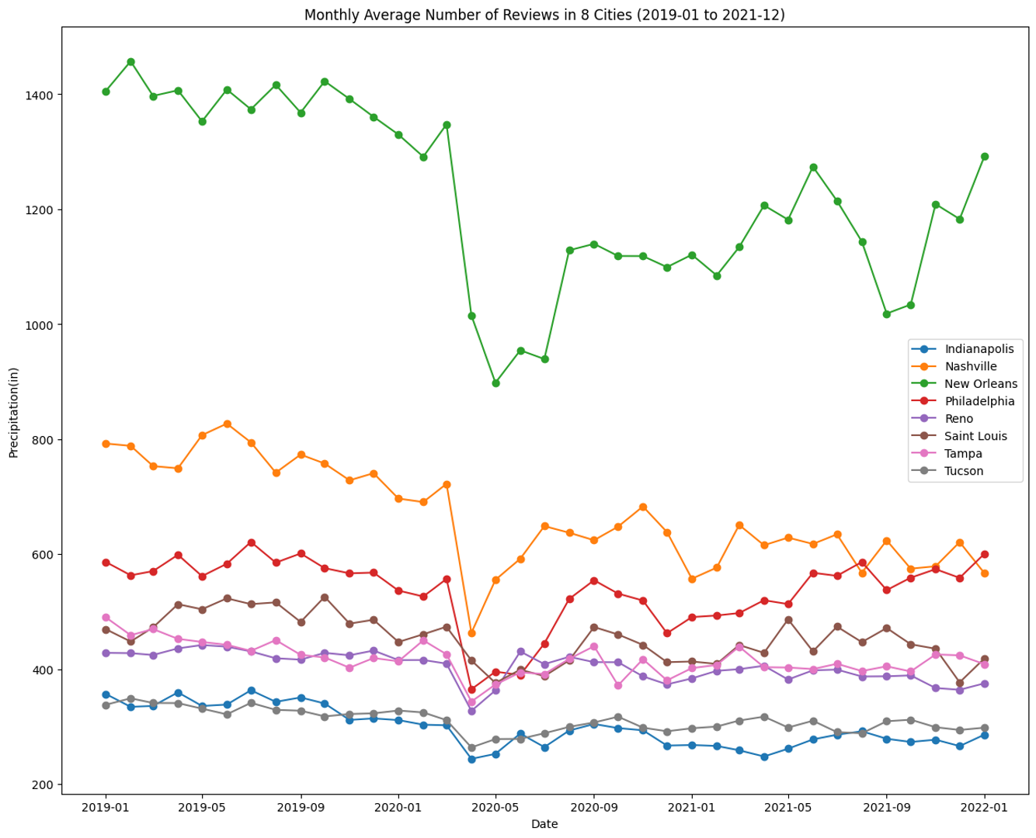
Monthly Average Number of Reviews in 8 Cities (01/2019 – 12/2021)
Similar in the trend of restaurant review counts across 8 cities
From March to April 2020, there was a sharp decline in reviews for all 8 cities.
New Orleans stands out with the highest review count

Slide 11
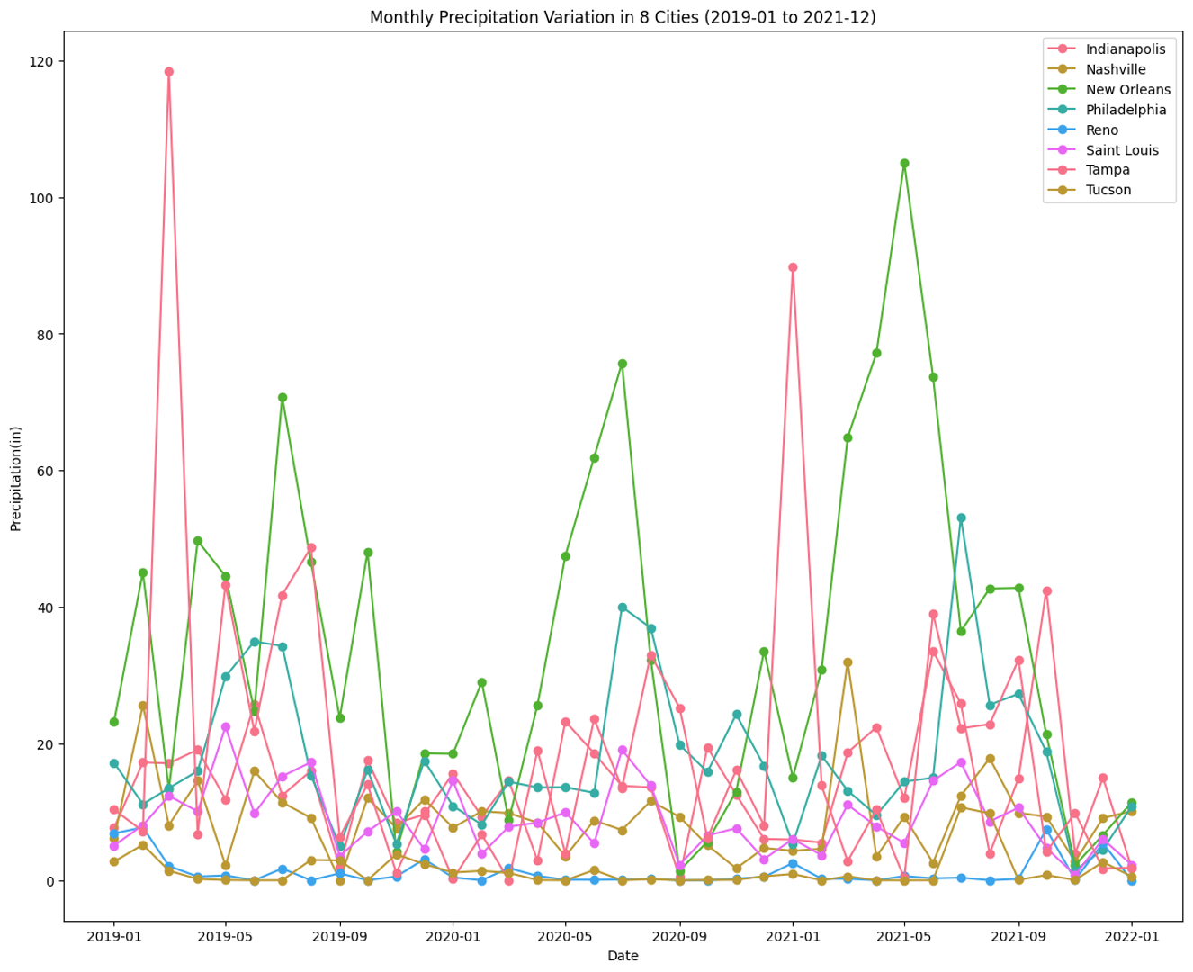
Monthly Precipitation Variation in 8 Cities (01/2019 – 12/2021)

Slide 12
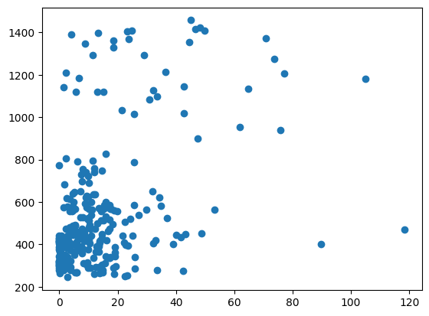
Scatterplot of correlation between Precipitation and average number of reviews
Correlation Coefficient: 0.45
Positive relationship
Moderate

Slide 13
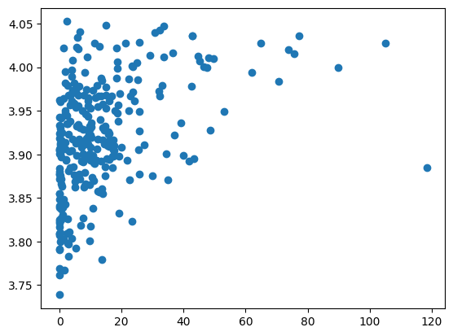
Scatterplot of correlation between Precipitation and average star of the restaurants
Correlation Coefficient: 0.42
Positive relationship
Moderate

Slide 14
Conclusion
Response to Hypotheses
There is no significant correlation between weather condition and review numbers of restaurants in selected cities.
Severity of abnormal weather events (e.g. storm, hail, snow) doesn't affect the average rating stars of restaurants in selected cities.
Possible Explanations
Local residents have been accustomed to weather conditions in the area.
Customer choose to dine out despite abnormal weather, indicating their loyalty and fondness for restaurants. In such condition, bad weather won't lower the rating of restaurants.
We selected average data for the correlation exploration, while abnormal weather events typically occur within a short timeframe. The average data may smoothed fluctuations of original data.

Slide 15
Conclusion
Limitation of Our Research
Sample size - The number of cities both existed in Yelp database and Weather Events database is limited. The project's finding may be limited by the sample size.
Due to time constraints, we opted for monthly average data, which may affect the measurement of correlations.
Future Improvements
Enhance the date matching between dates of weather events database and Yelp database
For example, refine from monthly average data to daily data
Obtain weather events data and yelp data from more representative cities for the correlation study.

